Slide 1

GYM-DATABASE MANAGEMENT SYSTEM

Slide 2
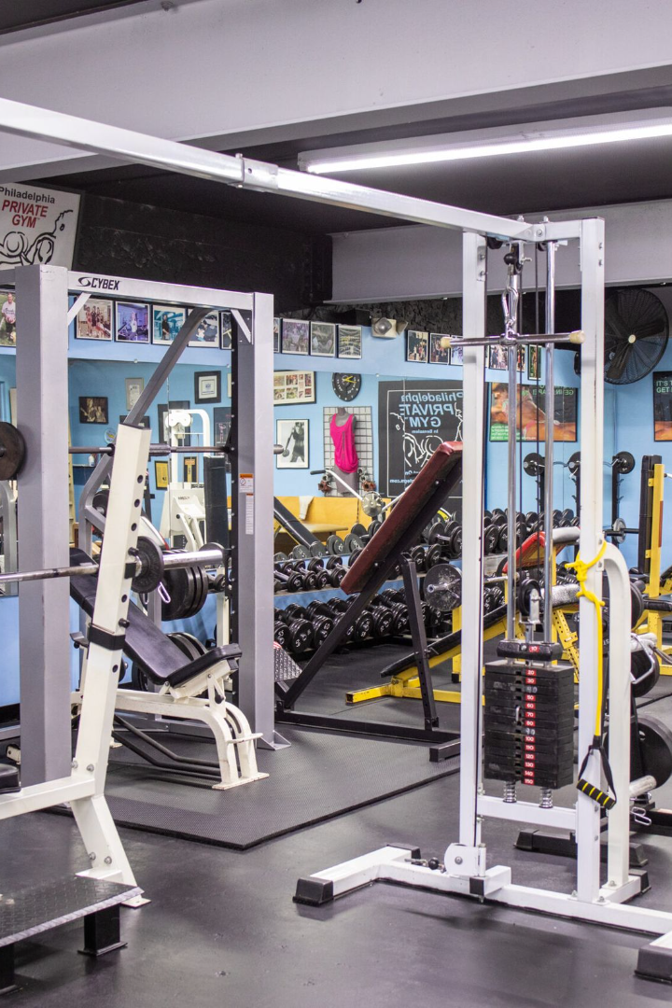
Team members:
SARANSH SINGH (RA2212703010013)
HEMA GIRI SAI BHUPATI (RA2212703010016)

Slide 3
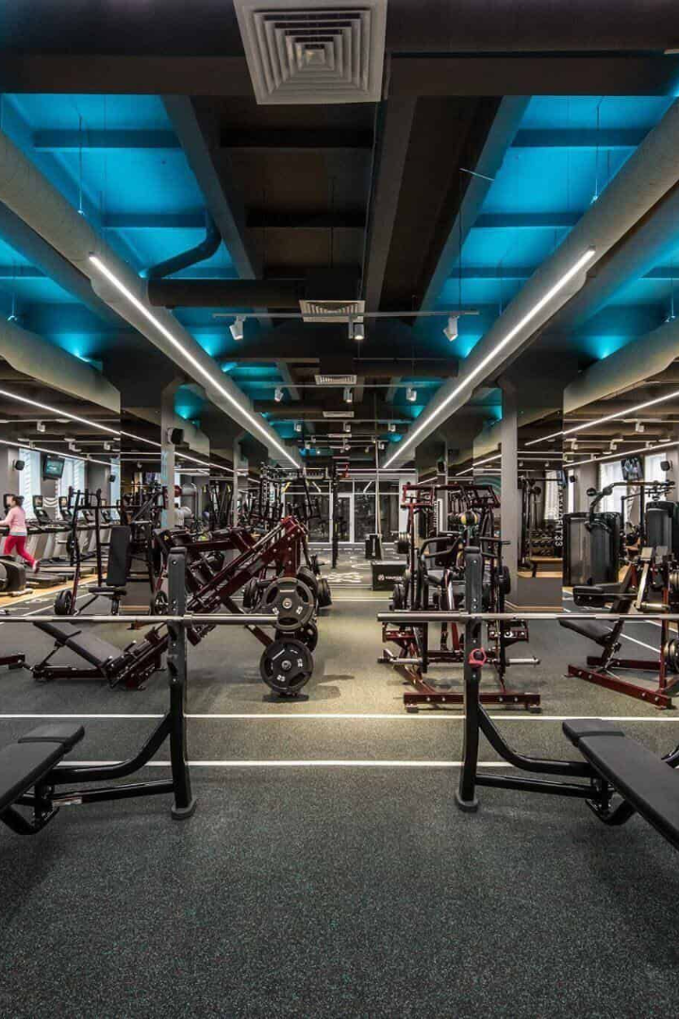
REVOLUTIONISE YOUR GYM EXPERIENCE
Introducing our new gym management system, designed to optimize your workouts and streamline the gym experience. Get ready to elevate your fitness routine!

Slide 4
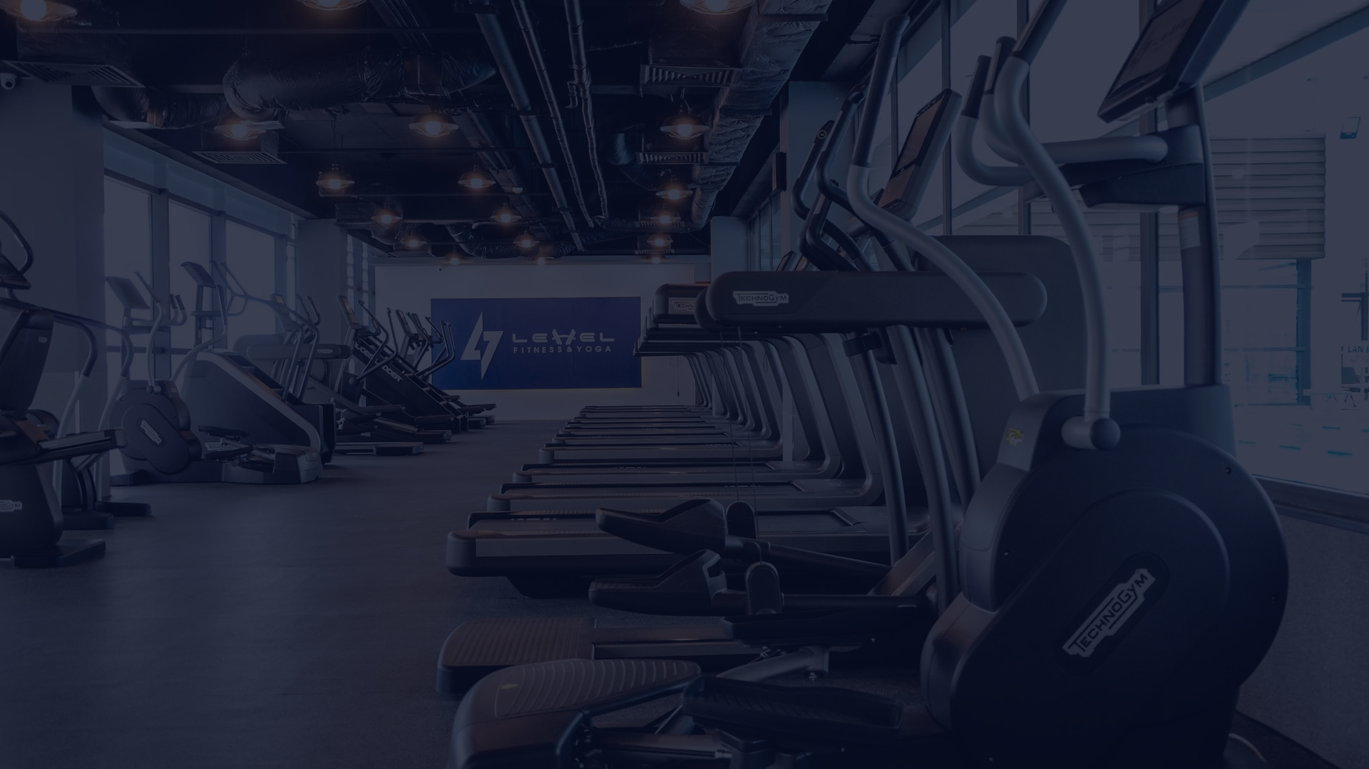
PROBLEM STATEMENT
A local gym wants to modernize its operations by implementing a Gym Management System. The gym currently maintains all member records manually, and it has become increasingly challenging to manage member information, track payments, and monitor equipment usage efficiently. The gym management seeks a software solution to streamline their operations, improve member experience, and simplify administrative tasks.

Slide 5
Purpose of the Project
Enhance the Gym Experience
Optimize Gym Operations
Better Access to Data
Our system processes and stores data to provide valuable insights into gym usage patterns and performance.
Our gym management system seeks to provide a seamless, comfortable, and efficient experience for gym-goers of any level.
With our system, g ym managers can streamline operations and improve productivity overall, freeing up more time for customer service and building the gym community.

Slide 6
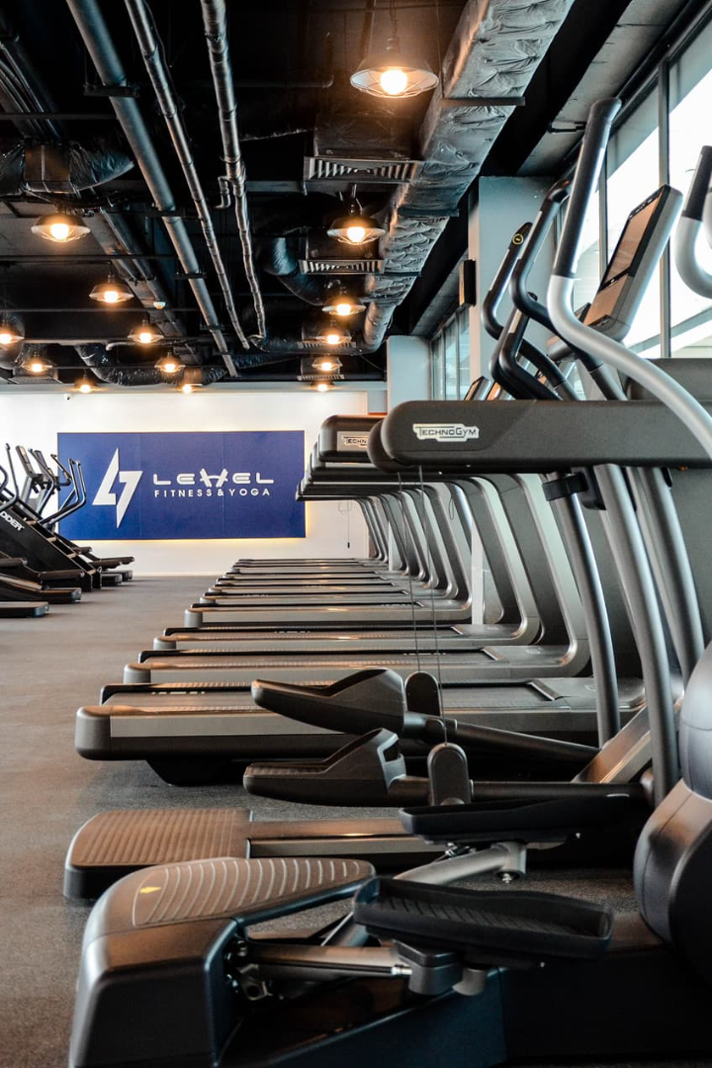
Objectives of the project
Efficiency: Streamline administrative tasks such as member registration, attendance tracking, and payment processing to improve the overall efficiency of gym operations.
Member Experience: Enhance the experience of gym members by providing tools for easy management of memberships, fitness progress tracking, and class sign-ups, ultimately fostering member satisfaction and loyalty.
Revenue Optimization: Optimize revenue management through automated billing, invoicing, and flexible membership plans, along with insights into financial performance to maximize profitability.
Data-Driven Decision Making: Enable informed decision-making by offering real-time reports and analytics on critical performance metrics such as membership statistics, attendance, and revenue.
Security and Privacy: Ensure the security and privacy of member data by implementing robust access controls, encryption, and compliance with data protection regulations, fostering trust and compliance

Slide 7
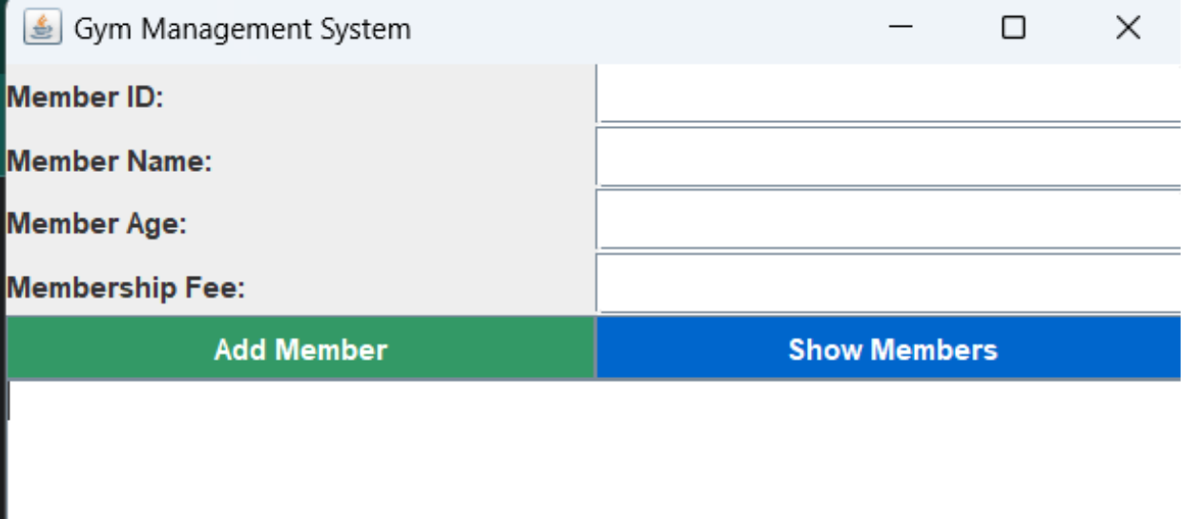
Sample front end design
This is a rough design of how our project is going to look like.

Slide 8
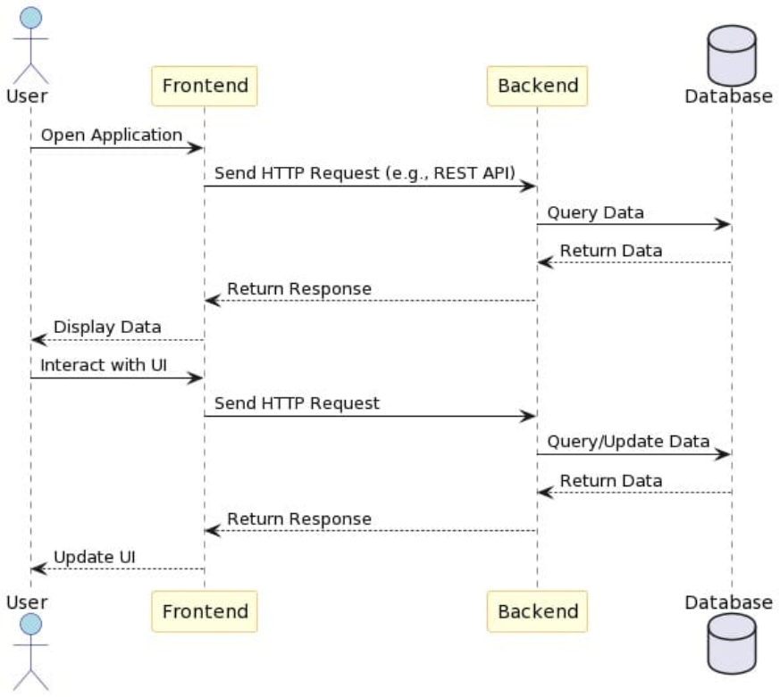
UML DIAGRAMS
1. SEQUENCE DIAGRAM:

Slide 9
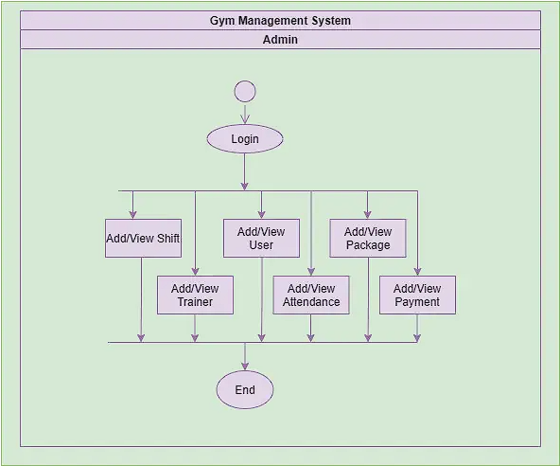
2.ACTIVITY DIAGRAM:

Slide 10
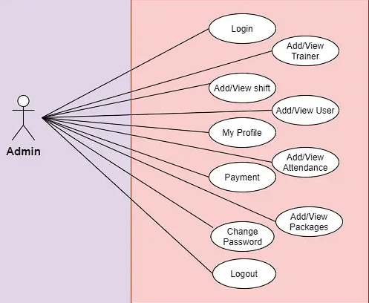
3.USE-CASE DIAGRAM:

Slide 11

Resources details
1
2
3
Frontend
Backend
Tools to be used
We will be using Java
We will be using the most basic but efficient SQLite for the backend data base management
Using any IDE will work such as Netbeans and IntelliJ IDEA community edition.
and a particular library called java swing for the GUI development.

Slide 12
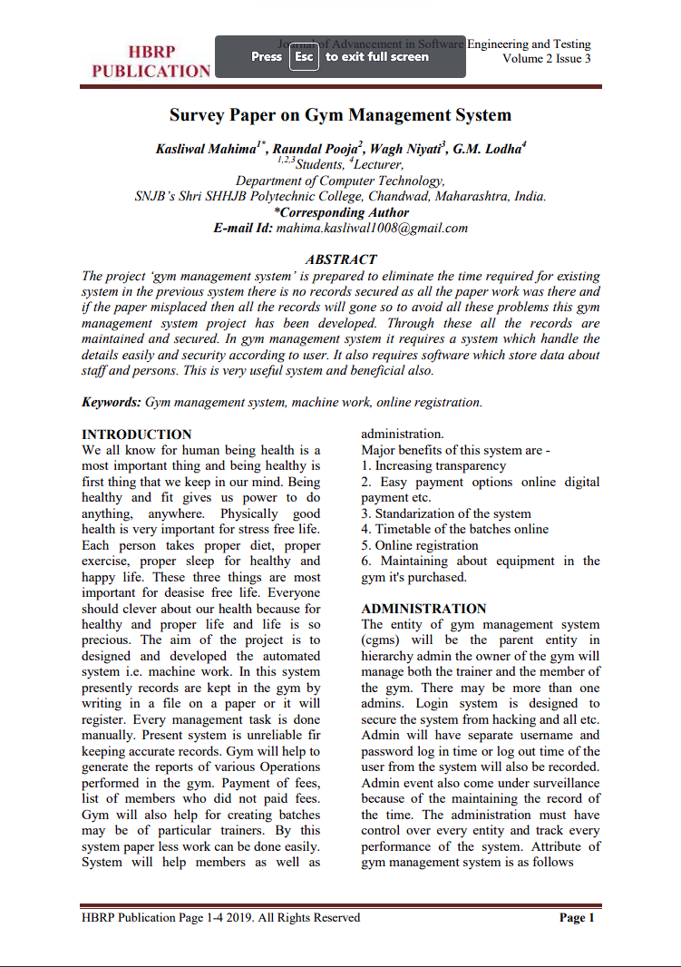
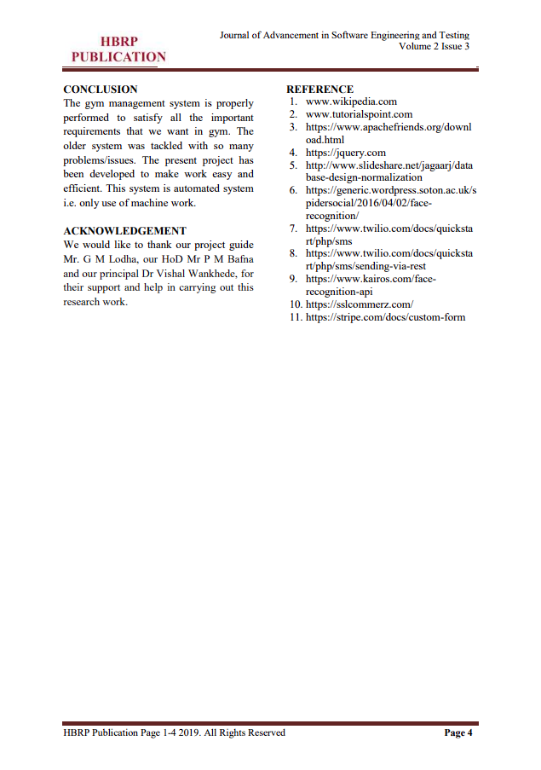
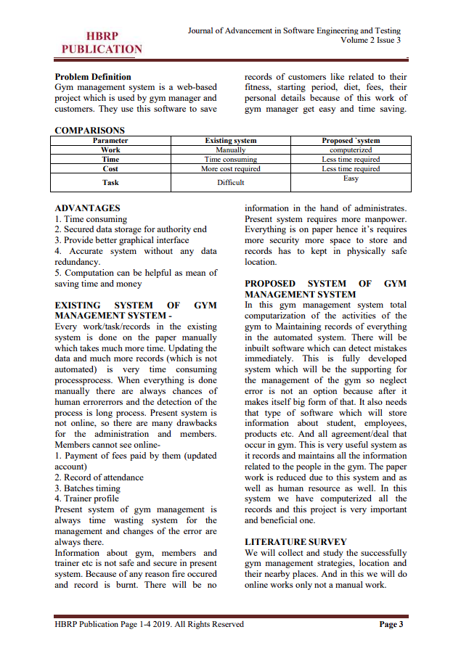

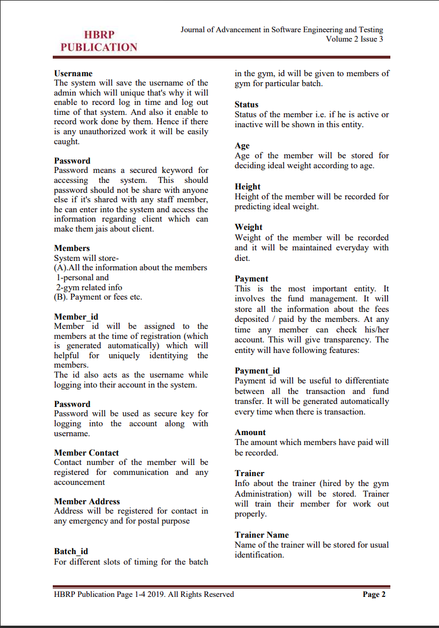
LITERARY SURVEY

Slide 13

Conclusion
In conclusion, our Gym Management System project represents a significant step forward in modernizing and improving the efficiency of gym operations. Through careful planning, design, and implementation, we have developed a robust software solution that addresses the key challenges faced by gym owners and staff while enhancing the overall experience for our members.

